Slide 1



Oct. 2021
PREDICTING CAR PRICES USING LINEAR REGRESSION
by Sultanah Aldossari& Rawan Alharbi

Slide 2
CONTENT
1
Introduction
2
Dataset
Exploratory Data Analysis
3
Pre-Processing
4
Modeling
5
Conclusion

Slide 3
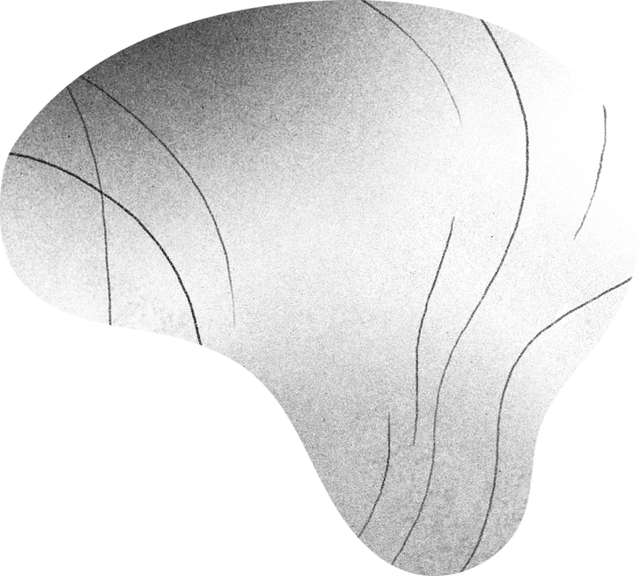
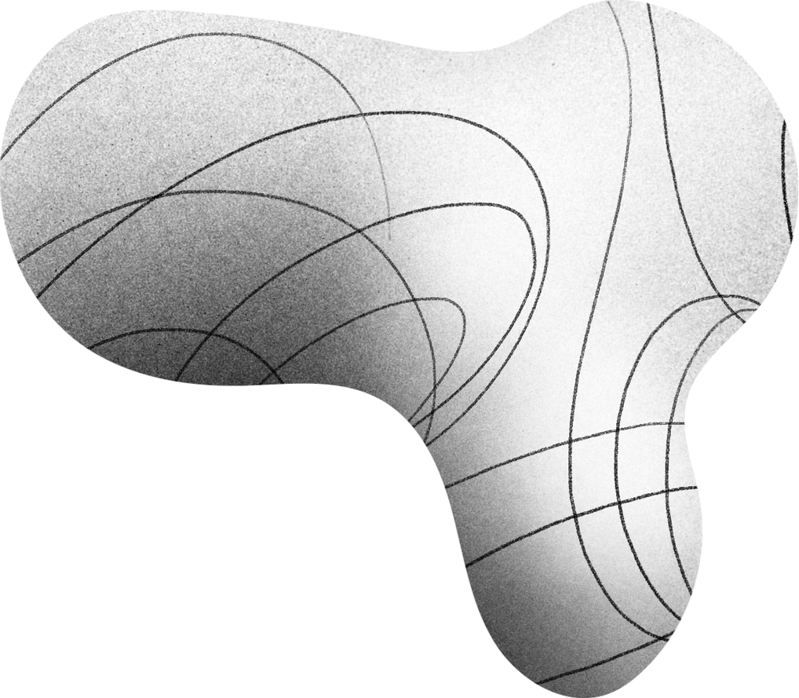
INTRODUCTION
PROBLEM STATEMENT
The purchase of a car can take a considerable amount of time.
It is possible to determine the actual worth of a car based on many factors.
The aim is to develop Linear regression model based on our data

Slide 4

DATASET
DATA
Data scraped using Selenium.
205 observations, 26 features.
Price is our target
The independent variables are divided into Categorical and Numerical variables.

Slide 5
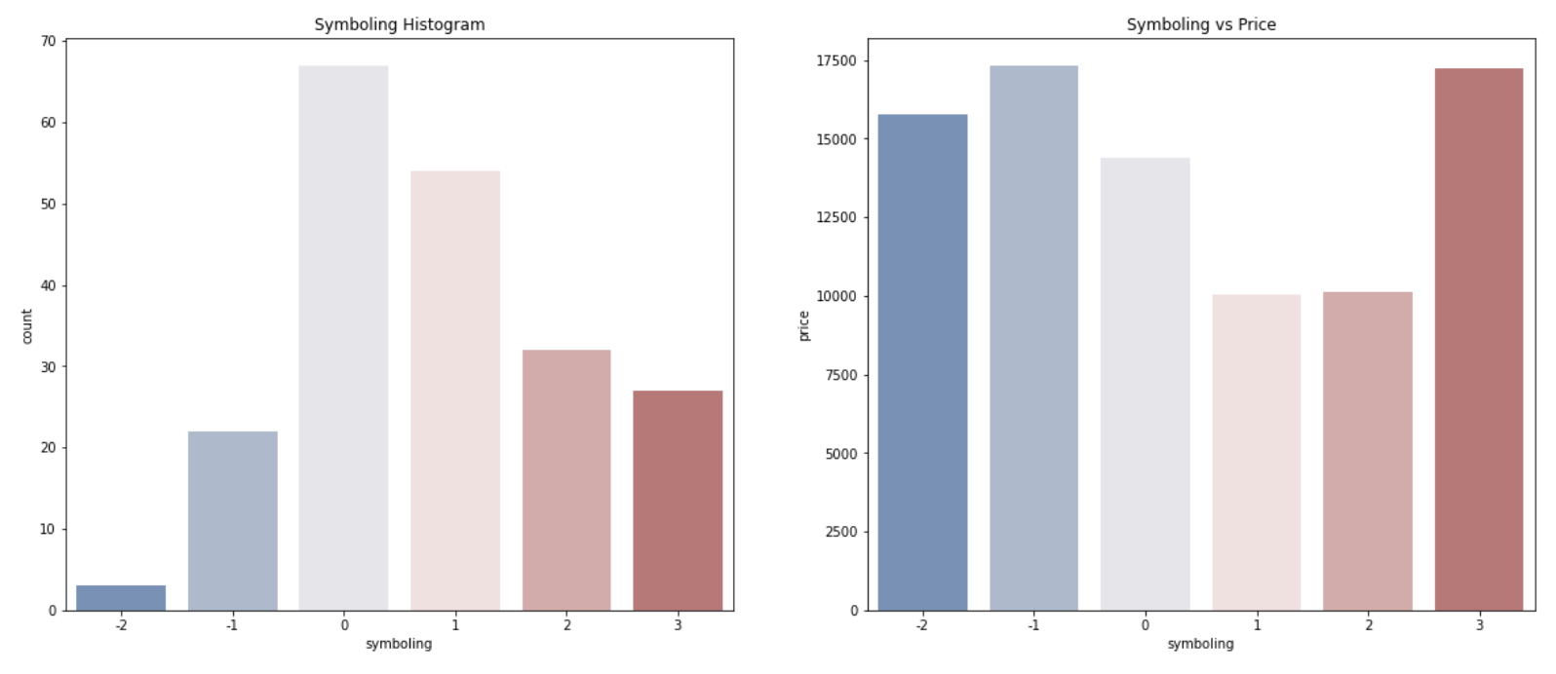
EXPOLARITY DATA ANALYSIS

Slide 6
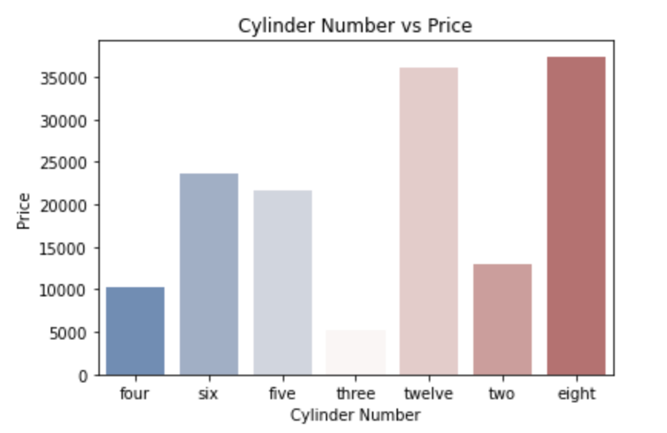
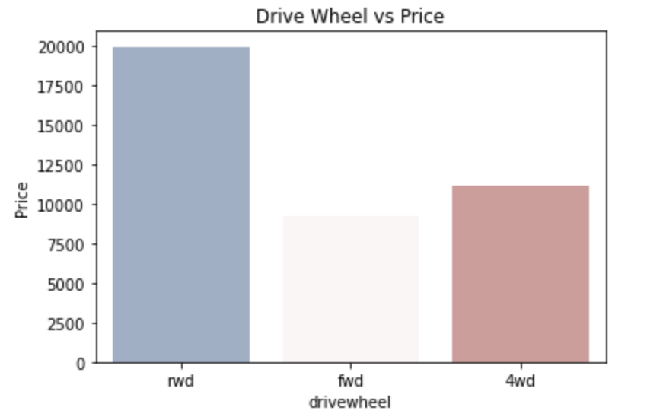
CONT: EXPOLARITY DATA ANALYSIS

Slide 7
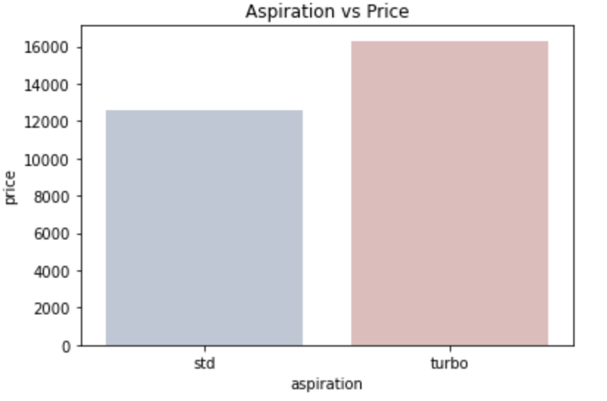
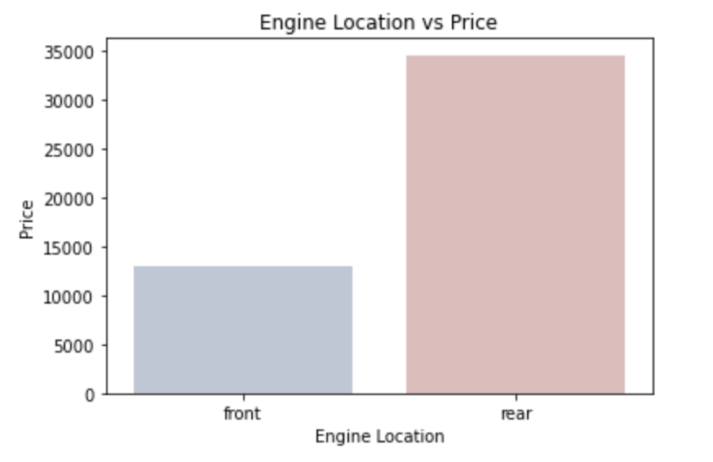
CONT: EXPOLARITY DATA ANALYSIS

Slide 8
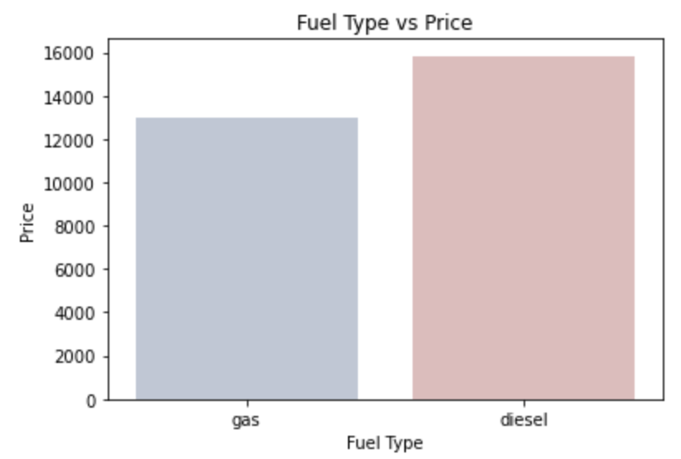
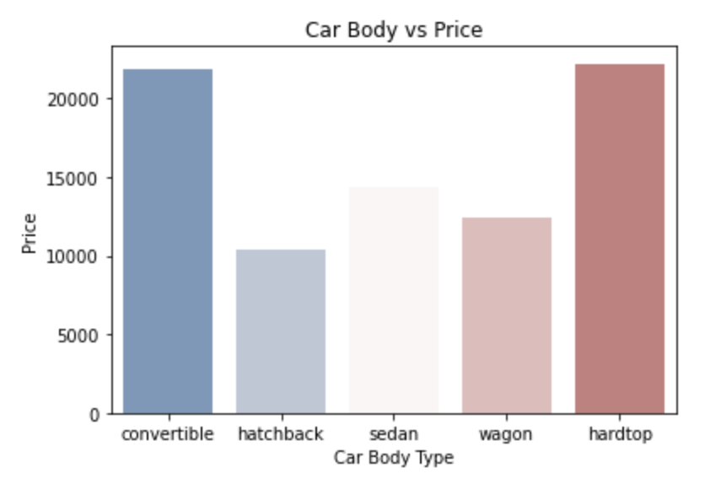
CONT: EXPOLARITY DATA ANALYSIS

Slide 9
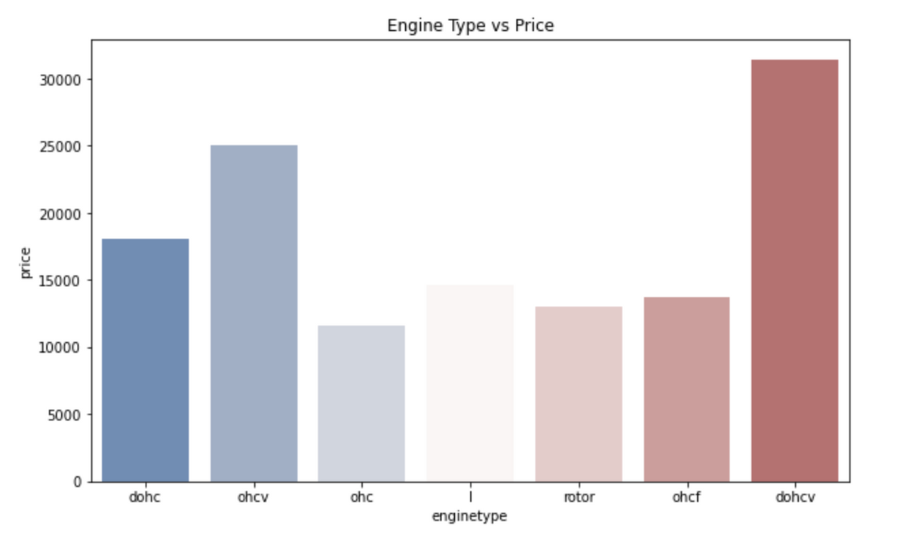
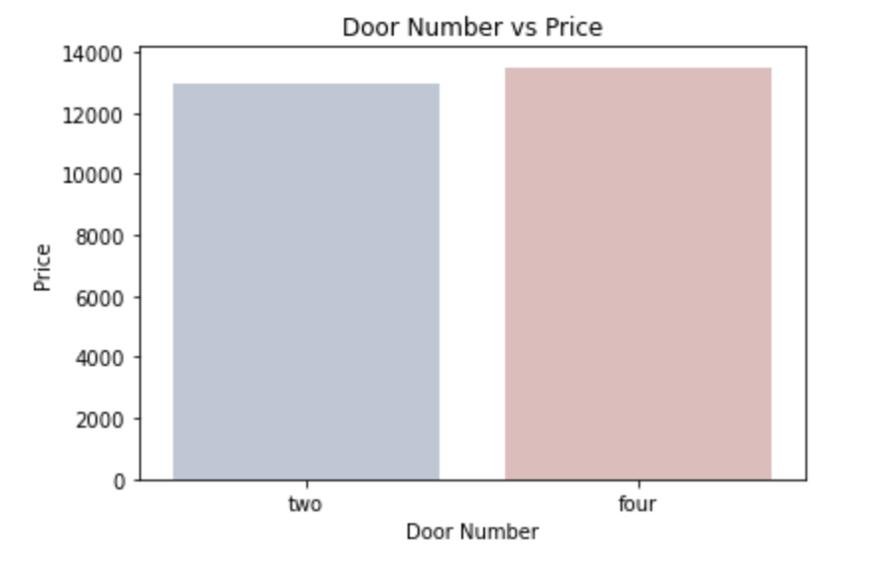
CONT: EXPOLARITY DATA ANALYSIS

Slide 10
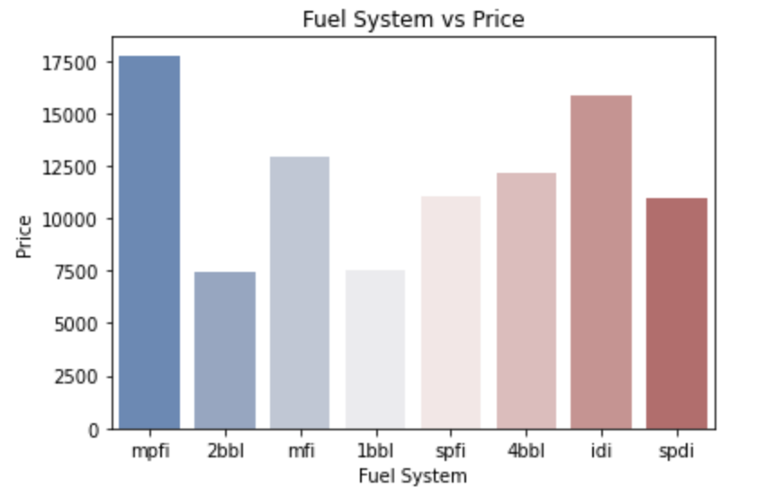
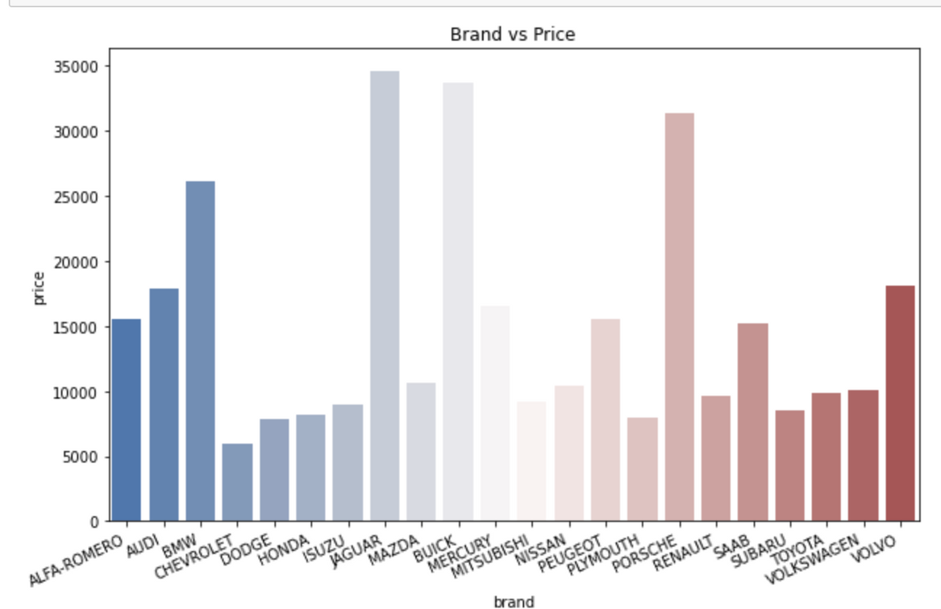
CONT: EXPOLARITY DATA ANALYSIS

Slide 11
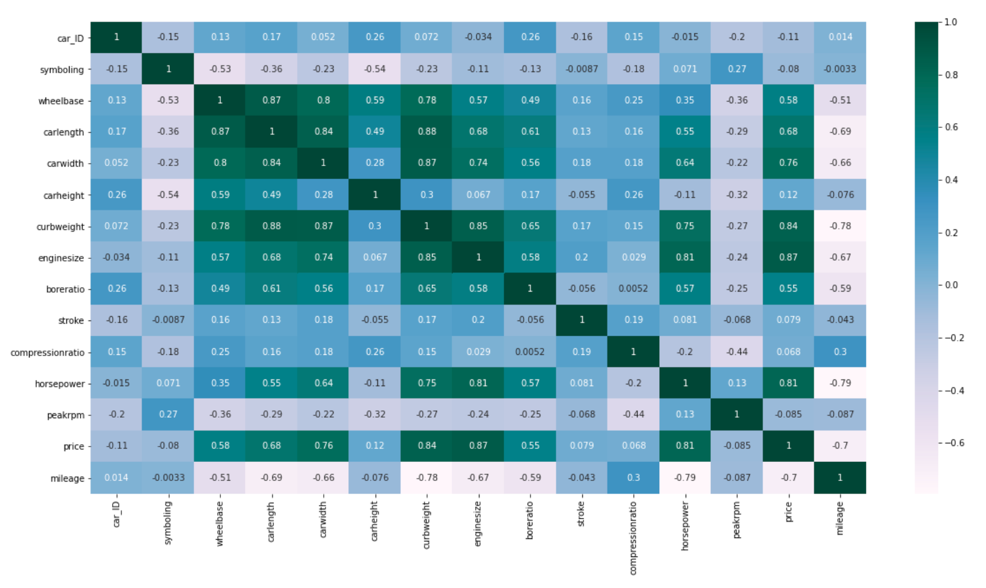
CONT: EXPOLARITY DATA ANALYSIS

Slide 12
CONT: EDA
After visualization we can derive some features that significantly affect the price .

Slide 13


PRE-PROCESSING
Converting categorical data into dummy variables
Derive a new features from our data
Scaled our data into the same scale
Created a new dataframe

Slide 14
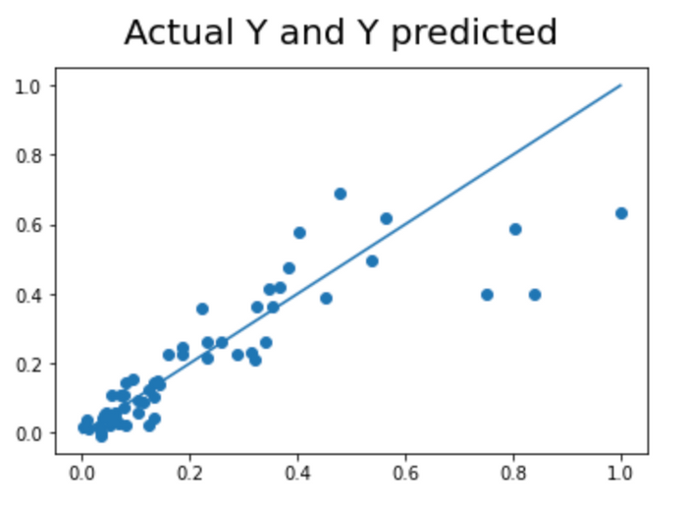
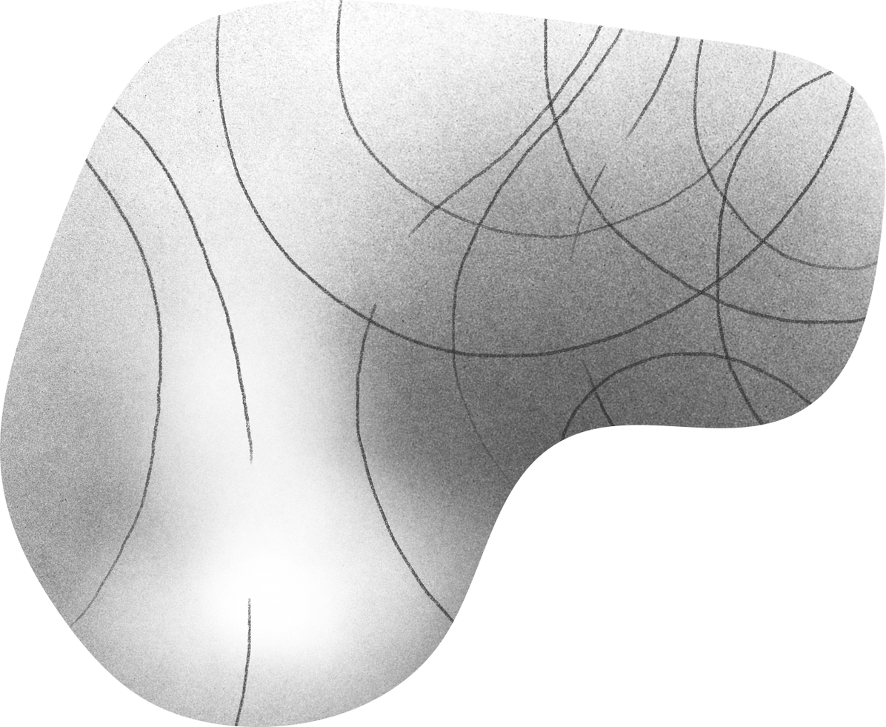
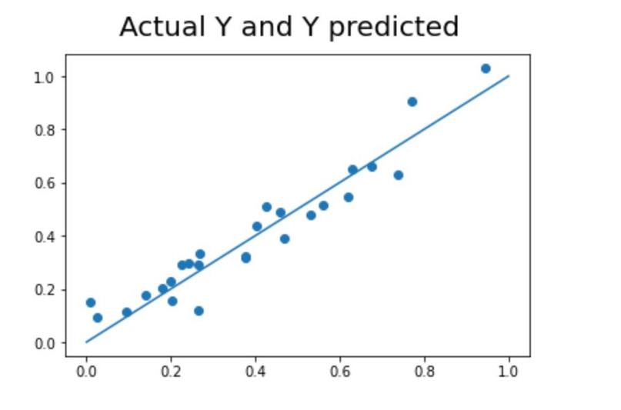
MODELING
Linear Regression
Split the data into train and test
Sklearn library were used
MSE Test Score = 0.012

Slide 15
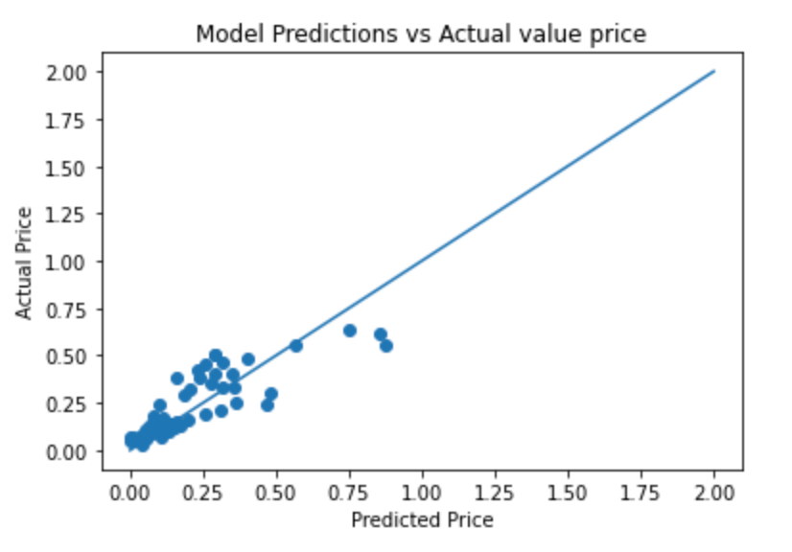
MODELING
Lasso Regression
Split data into train and test
The best Alpha value were 0.01
MSE Test Score = 0.012

Slide 16
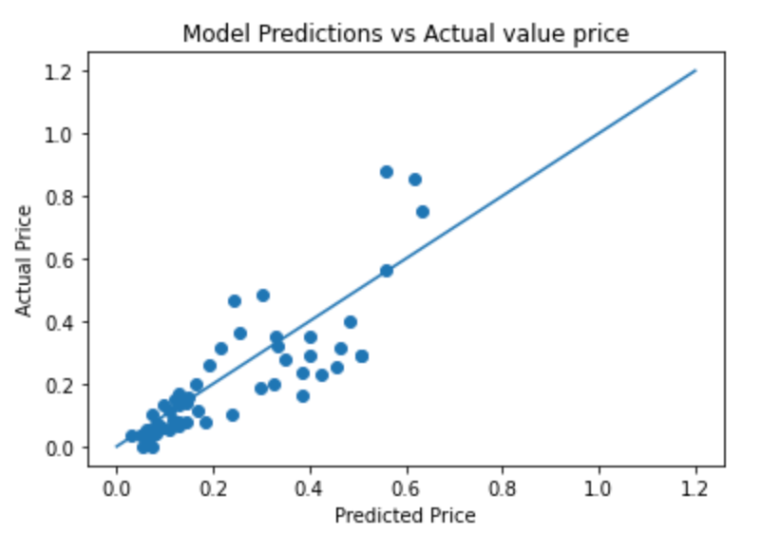
MODELING
Lasso Regression
After Feature Selection
MSE Test Score = 0.011

Slide 17
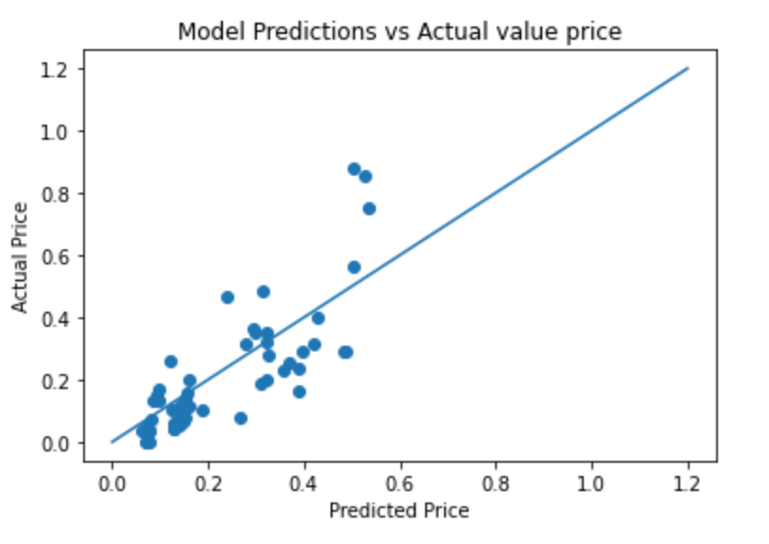
MODELING
Ridge Regression
MSE Test Score = 0.013

Slide 18
CONCLUSION

Slide 19


THANK YOU!

